Slide 1


INTRODUCING
Gas and electric
COOKTOPS
10.10.13

Slide 2
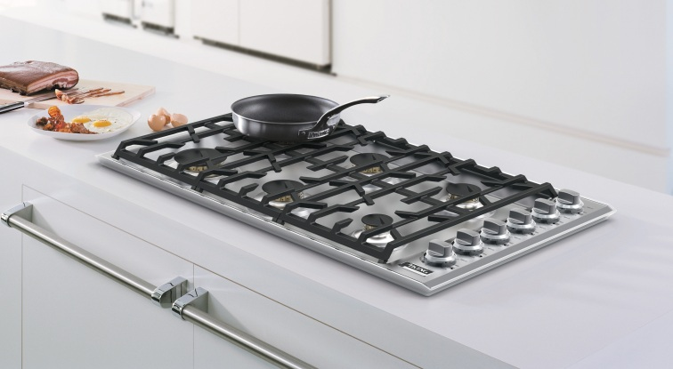
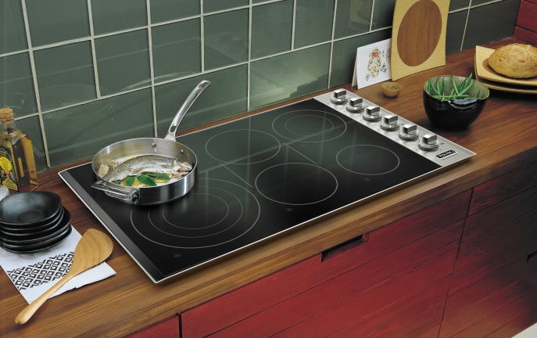
Sophisticated Simplicity
NEW, sleek and innovative design coordinates perfectly with the entire Viking Professional line of products
Boasting the most powerful 30” and 36” wide gas cooktops in the industry, Viking Professional gas cooktops offer a hassle-free kitchen upgrade with superior cooking power.
Up to 10 cooking zones on the Viking Professional electric cooktops provide the fastest boiling times and best simmer of cooktops in the luxury segment.
Backed by the industry’s best Viking Signature 3-Year Warranty, Viking is committed to customer satisfaction with every product that comes off the line.

Slide 3
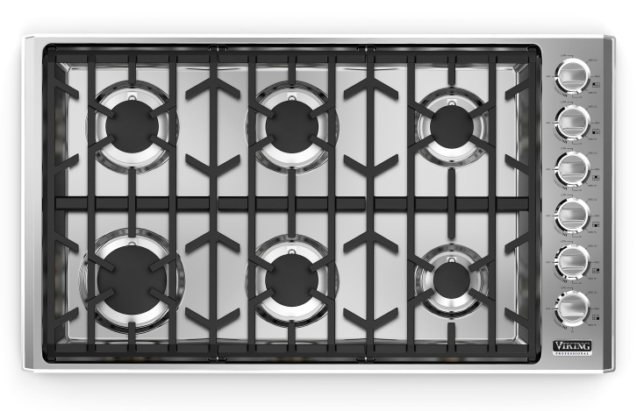
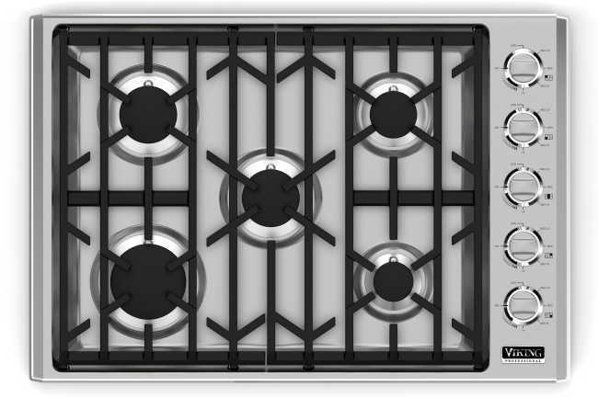
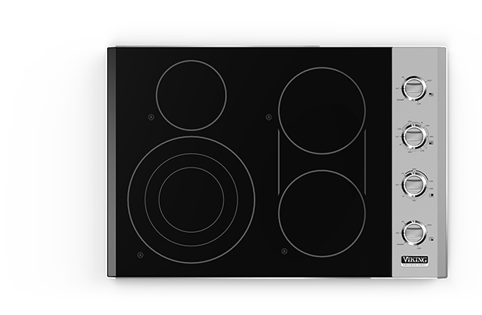
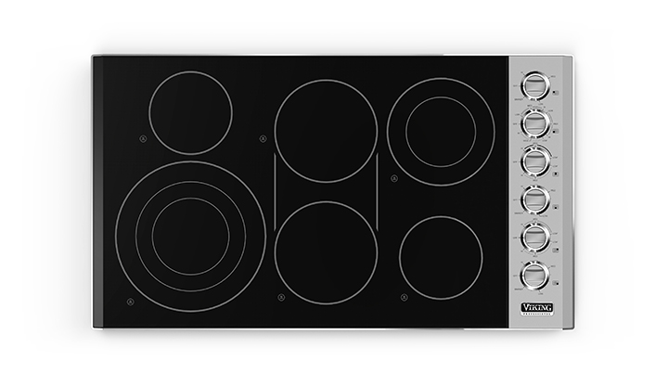
Viking Professional Cooktops
30”W. GAS COOKTOP
36”W. GAS COOKTOP
30”W. ELECTRIC COOKTOP
36”W. ELECTRIC COOKTOP

Slide 4
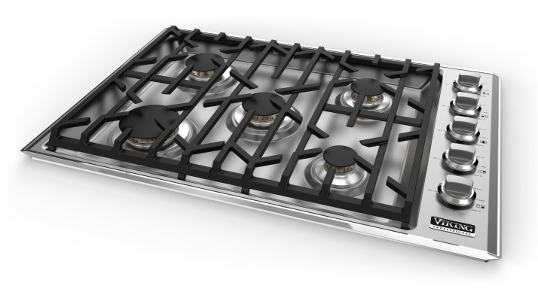
VGC Gas Cooktops
30” WIDE – 5 BURNERS
FEATURES
5 BURNERS - Wide variety of burner sizes with brass flame ports provide 56,000 BTUs of power and performance
  The HIGHEST combined BTU rating of 30”W. cooktops in the industry
  Powerful 18,000 BTU burner delivers commercial power for high heating sautéing, rapid boiling and quick recovery
  Simmer settings on all burner allow low BTU output for heating delicate sauces
Burner Sizes
  18,000 BTU HIGH OUTPUT burner (left front)
  12,000 BTU burner (left rear)
  12,000 BTU burner (center)
  8,000 BTU burner (right rear)
  6,000 BTU burner (right front)
EXCLUSIVE SureSpark™ Ignition System ensures automatic ignition/re-ignition should the flame extinguish at any time while cooking
Continuous cooking grates allows for easy movement of pots and pans across the cooking surface
One piece tooled top with large spill collection area holds up to 8 cups of liquid, making clean-up easy and quick
EXCLUSIVE ScratchSafe™ Grate Design provides ultimate protection from scratches and ensures proper placement of the heavy-duty grates
Childproof, push-to-turn metal knobs for safe use
Customer-removable knobs, grates, and burner caps make clean-up easy
Durable laser-etched graphics withstand the rigors of regular cleaning
MODEL NUMBER
VGC530-5B

Slide 5
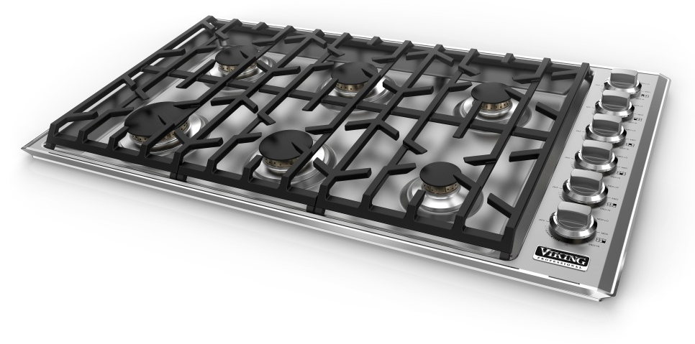
VGC Gas Cooktops
36” WIDE – 6 BURNERS
FEATURES
6 BURNERS - Wide variety of burner sizes with brass flame ports provide 66,000 BTUs of power and performance
  The HIGHEST combined BTU rating of 36”W. cooktops in the industry
  Powerful 18,000 BTU burner delivers commercial power for high heating sautéing, rapid boiling and quick recovery
  Simmer settings on all burner allow low BTU output for heating delicate sauces
Burner Sizes
  18,000 BTU HIGH OUTPUT burner (left front)
  10,000 BTU burner (left rear)
  12,000 BTU burner (center front)
  12,000 BTU burner (center rear)
  8,000 BTU burner (right rear)
  6,000 BTU burner (right front)
EXCLUSIVE SureSpark™ Ignition System ensures automatic ignition/re-ignition should the flame extinguish at any time while cooking
Continuous cooking grates allows for easy movement of pots and pans across the cooking surface
One piece tooled top with large spill collection area holds up to 11 cups of liquid, making clean-up easy and quick
EXCLUSIVE ScratchSafe™ Grate Design provides ultimate protection from scratches and ensures proper placement of the heavy-duty grates
Childproof, push-to-turn metal knobs for safe use
Customer-removable knobs, grates, and burner caps make clean-up easy
Durable laser-etched graphics withstand the rigors of regular cleaning
MODEL NUMBER
VGC536-6B

Slide 6
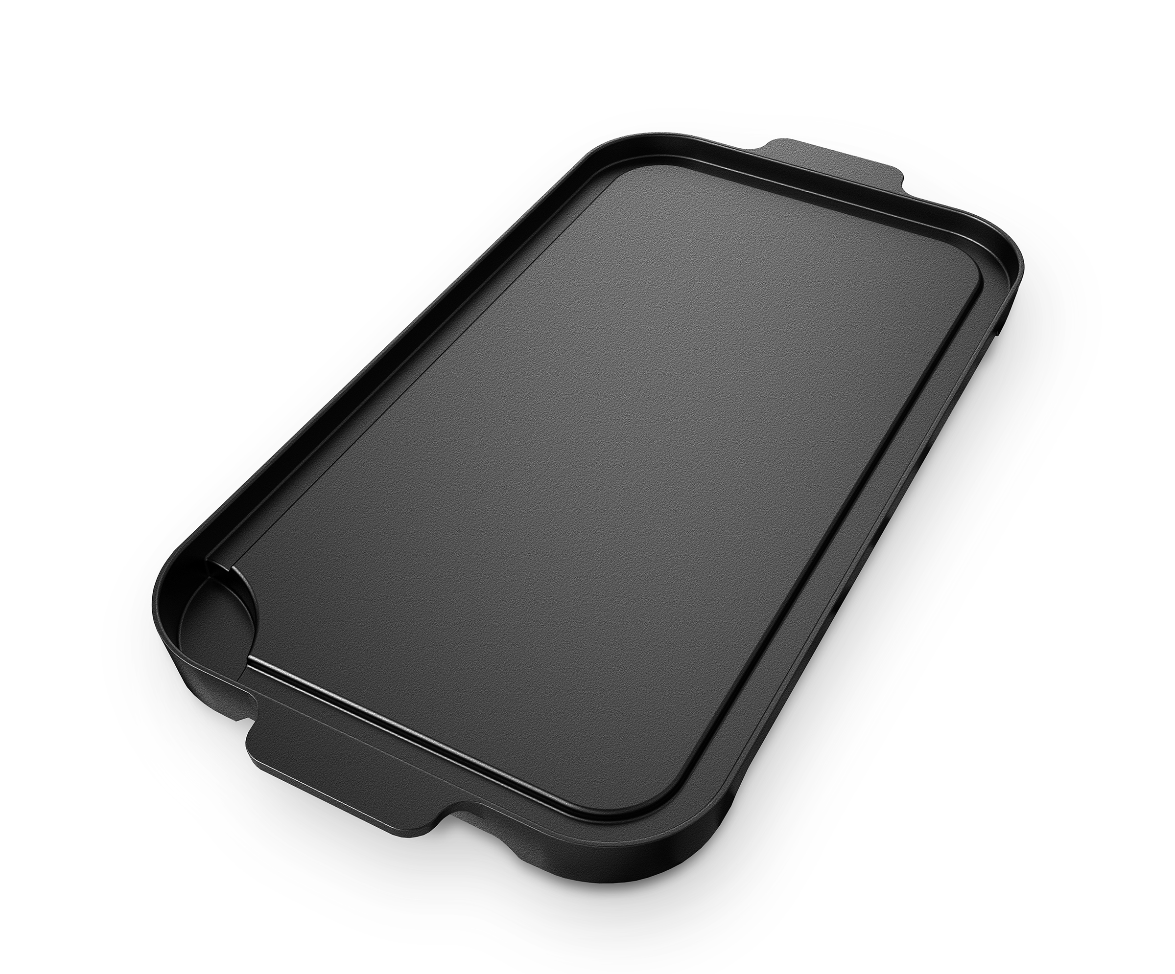
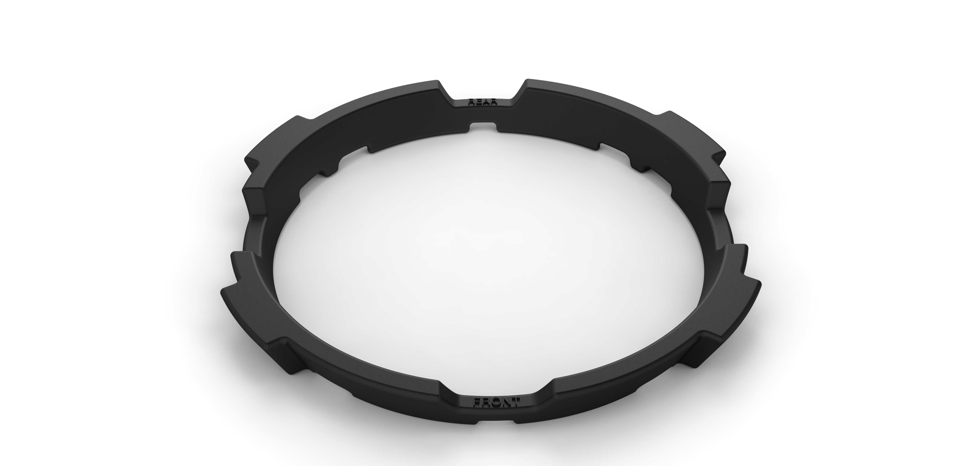
VGC Gas Cooktops
ACCESSORIES
MODEL NUMBER
PGDVGC
MODEL NUMBER
WRGVGC
Portable, non-stick cast-aluminum griddle fits securely onto burner grates to provide a griddling surface; great for fast defrosting of foods
Porcelain coated cast-iron wok ring fits securely over standard porcelain coated grate to accommodate wok cooking
Gas conversion kits also available:
LPKVGC – Natural to LP Conversion Kit
NKVGC – LP to Natural Conversion Kit

Slide 7
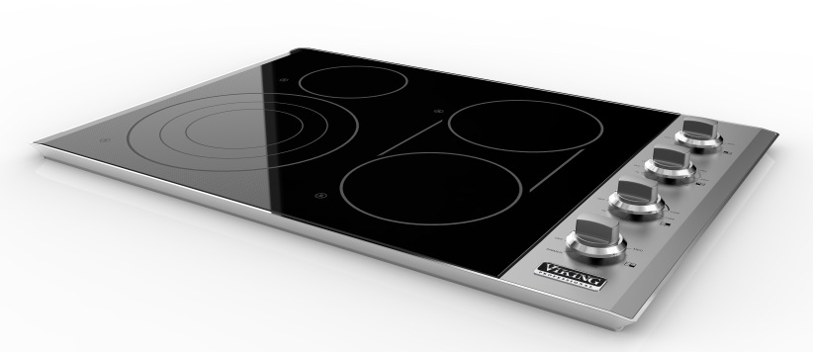
VEC Electric Cooktops
30” WIDE – 4 ELEMENTS
FEATURES
7 cooking zones with various wattages including a NEW 12” 3,200 watt triple element provide space and power options for most cookware
QuickCook™ Surface Infrared Elements utilize ribbon technology to reach full power in about 3 seconds
Element Sizes
  12” – 3,200 watt triple element (left front)
  6.5” – 1,200 watt single element (left rear)
  8.5” – 1,800 watt single element (right front)
  8.5” – 1,800 watt single element (right rear)
  Bridge – 800 watt element
Bridge element connects front and rear elements to
create a continuous heated surface for large cookware or optional griddle accessory
Infrared energy transfer provides fast cooking, regardless of the type of cookware used
Strong, wear-resistant glass ceramic cooking surface makes clean-up easy and quick
Indicator lights display when element is active or surface is hot
Childproof, push-to-turn metal knobs for safe use
Durable laser-etched graphics withstand the rigors of regular cleaning
MODEL NUMBER
VEC530-4B

Slide 8
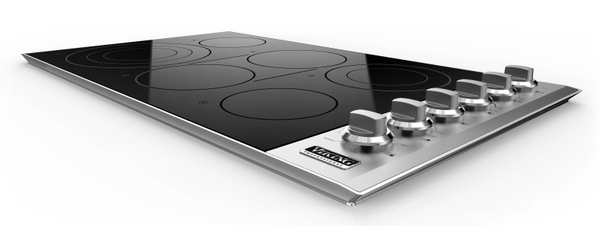
VEC Electric Cooktops
36” WIDE – 6 ELEMENTS
FEATURES
10 cooking zones with various wattages including a NEW 12” 3,200 watt triple element provide space and power options for most cookware
QuickCook™ Surface Infrared Elements utilize ribbon technology to reach full power in about 3 seconds
Element Sizes
  12” – 3,200 watt triple element (left front)
  6.5” – 1,200 watt single element (left rear)
  8.5” – 1,800 watt single element (center front)
  8.5” – 1,800 watt single element (center rear)
  6.5” – 1,200 watt single element (right front)
  8.5” – 2,000 watt dual element (right rear)
  Bridge – 800 watt element
Bridge element connects front and rear elements to
create a continuous heated surface for large cookware or optional griddle accessory
Infrared energy transfer provides fast cooking, regardless of the type of cookware used
Strong, wear-resistant glass ceramic cooking surface makes clean-up easy and quick
Indicator lights display when element is active or surface is hot
Removable stainless steel knobs with childproof, push-to-turn safety feature
Durable laser-etched graphics withstand the rigors of regular cleaning
MODEL NUMBER
VEC536-6B

Slide 9
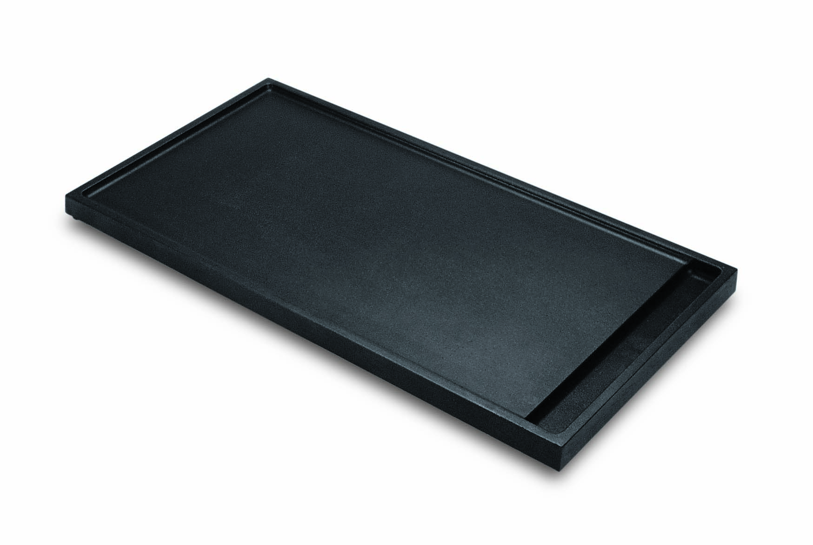
VEC Electric Cooktops
ACCESSORY
Portable, non-stick cast-aluminum griddle fits securely onto glass surface to provide a griddling surface; great for fast defrosting of foods
MODEL NUMBER
PGDVEC

Slide 10
Available Finishes
GAS COOKTOPS
Available in Stainless Steel
(order as Natural or LP)
ELECTRIC COOKTOPS
Available in Stainless Steel
with Black Glass

Slide 11
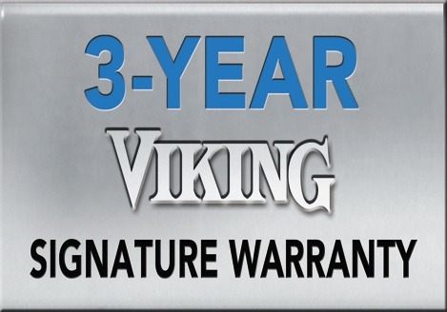
Three-Year Warranty and Made in the USA
Viking Professional products are proudly made in Greenwood, Mississippi, using high-grade, heavy-duty materials, then backed by our signature three-year warranty. From engineering to manufacturing to quality control, Viking is committed to customer satisfaction with every product that comes off the line.

